Slide 1

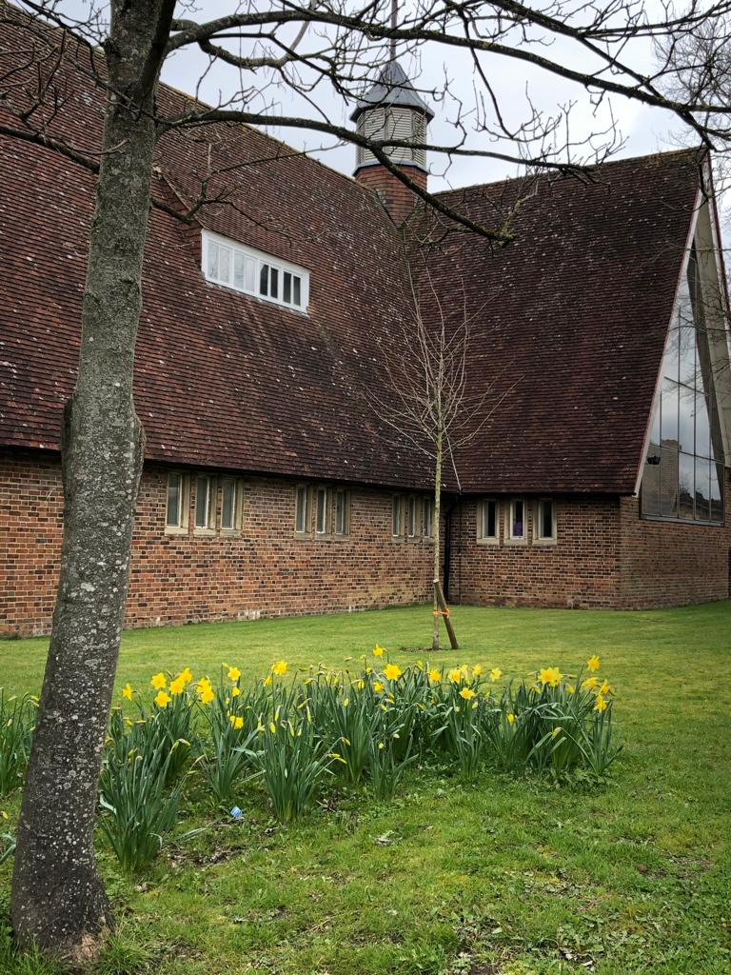
WELCOME
Thank you for joining us today at
Christ The King
A place to belong, a place to believe,
a place to become.
www.salfordschurch.org

Slide 2
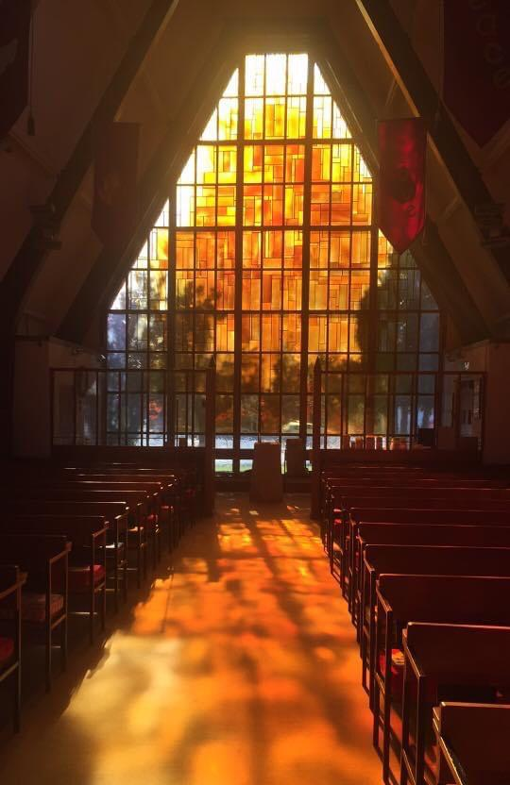
Services at Christ The King
The church was built by the community, for the community and is located in the heart of Salfords Village. The form of our services, The Liturgy, follows the liberal Catholic tradition of the Church of England.
Sunday Mass, 10am
We follow an order of service book with Bible readings, prayers and hymns. We use incense and ring bells as part of our tradition. The lighting of candles is also an important part of our services (see enclosed leaflet).
After Mass, please join us for a coffee or tea – time for a chat and fellowship.
“Surely it is God who saves me...”
Isiah

Slide 3
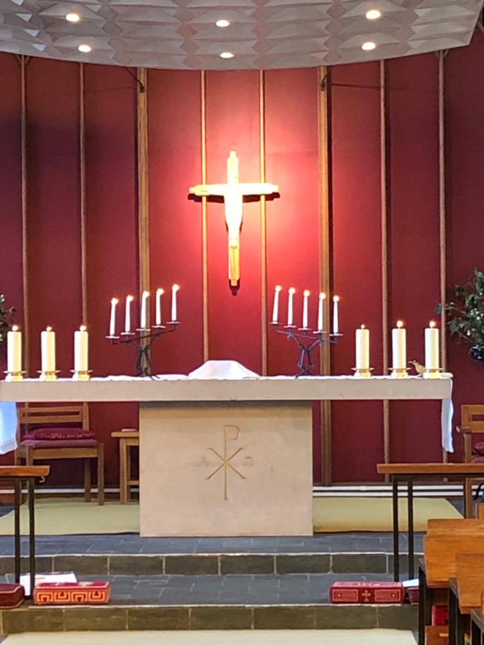
Our services
Wednesday Chapel Mass, 10am
A Said Mass in our Chapel, followed by refreshments.
Vespers & Benediction (Also known as Evening Prayer) once a month, 6pm on the third Sunday
This is a short, quiet and contemplative service centred around the Psalms, incorporating prayer, hymns and readings. This is followed by refreshments and an opportunity to chat.
.
Meditative prayer group meeting, once a month at 10.30am on the third Tuesday
A short time of prayer with readings and music. It is peaceful and restorative. Please see enclosed leaflet.
We also have a number of other services for special dates in the Church year (please see enclosed calendar).
“This is Christ The King, whom shepherds guard and angel sing,; Haste to bring him laud, The Babe, the son of Mary”.

Slide 4
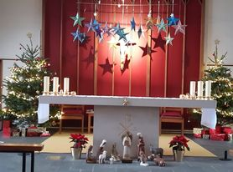
Who’s who
The Clergy team
Priest-in-charge: Vacancy
Hon. assistant: Revd Doug Ross
Revd Frances Plummer
You are welcomed by our Sides Persons and Verger on entry to the church. We are a friendly group, please ask for any assistance you need, be it related to the order of the Mass or anything else.
Our Church Wardens are members of the church family, with special responsibilities, and are always happy to be of assistance.
Happy are the people the Lord has chosen as his own.
Psalm 32

Slide 5

Connect with us
We are glad that you joined us today. Please take this opportunity to tell us more about yourself so that we can make you feel welcome.
Name:
Address:
Telephone number:
Email:
Please indicate if you are happy to be contacted :- Yes/No
We occasionally record services and or take photos which we use on our website or on our Facebook page. Please tell us if you are happy to be included.
Yes/No
Tell us more about yourself:
_________________________________________________________________________________________________________________________________________________________
Your privacy is important to us and you can find out more about how we use your personal data by reading our Privacy Notice which you can find at salfordschurch.org or please ask for a paper copy.
Christ is counting on us, we are counting on him.

